Slide 1
Backpropogation

Slide 2

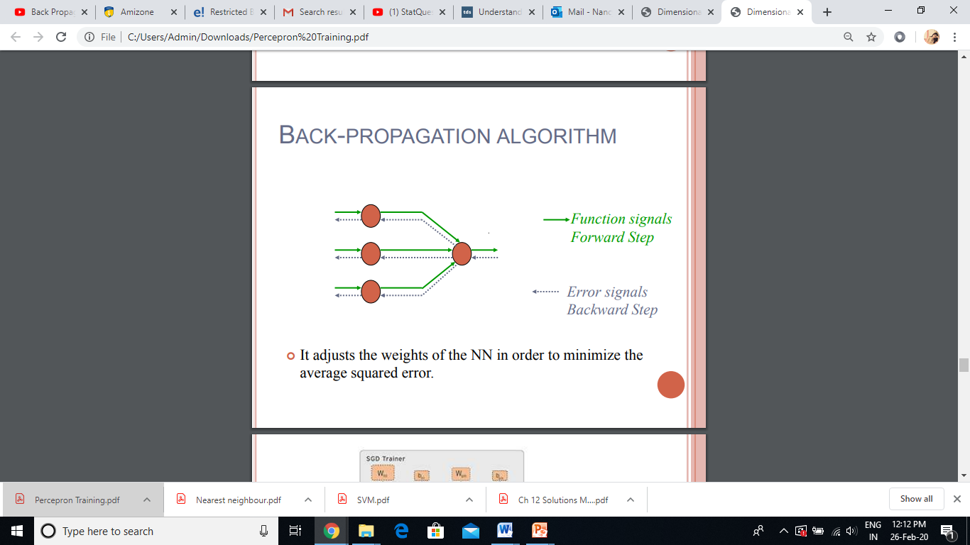
Backpropogation: Basic Steps

Slide 3
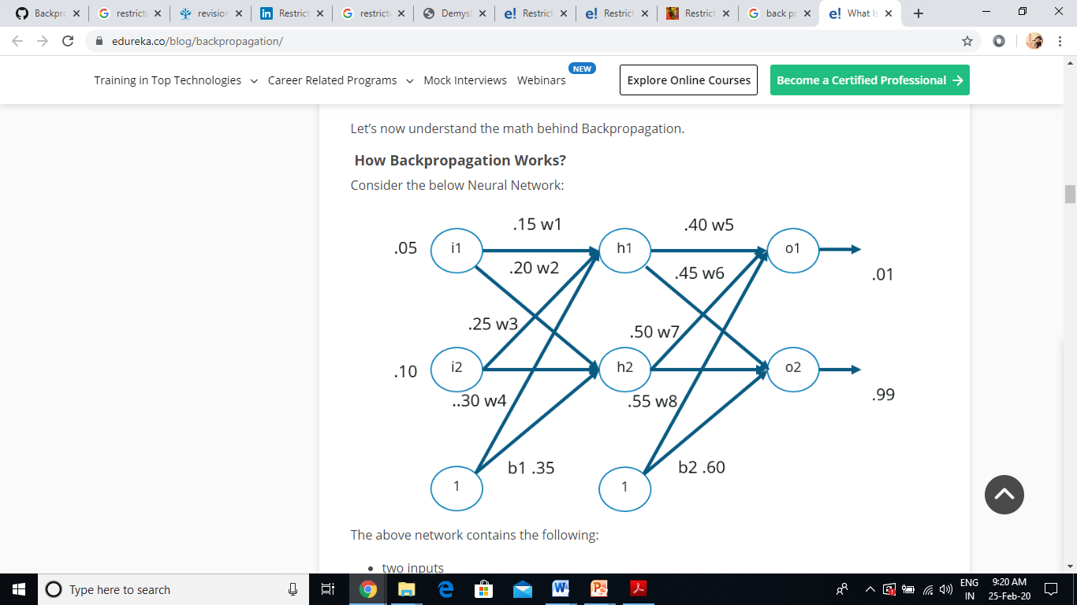
Backpropogation

Slide 4

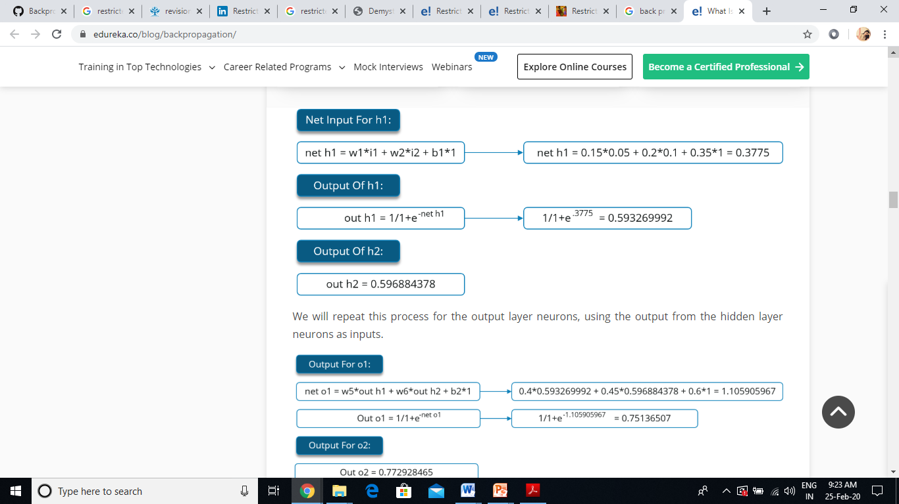
Step1: Forward Pass

Slide 5
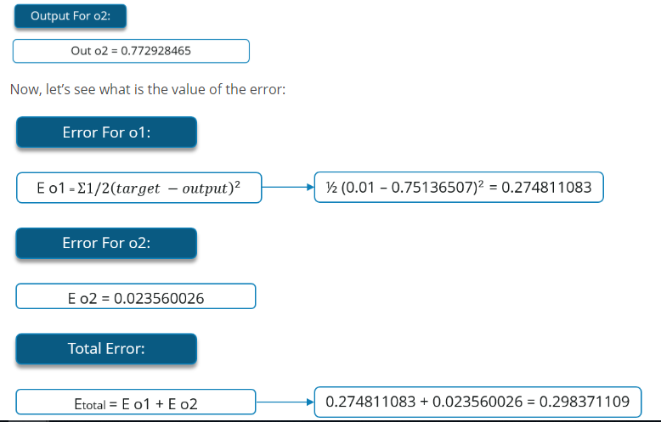
Forward Pass

Slide 6
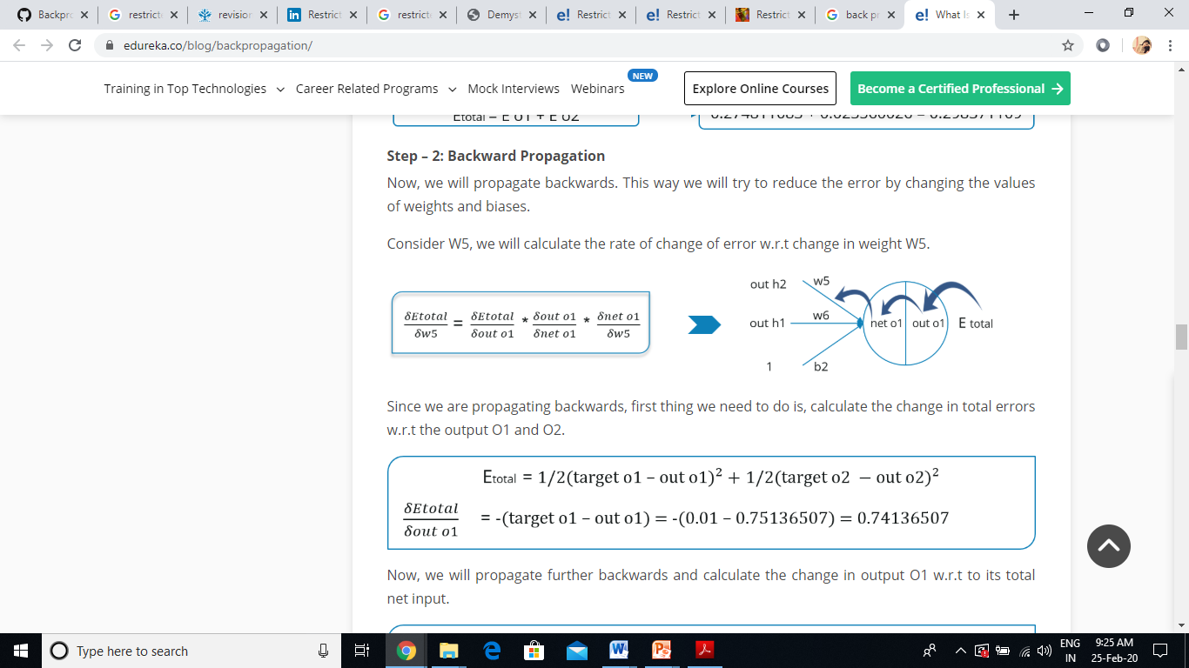
Step2: Backward Pass

Slide 7
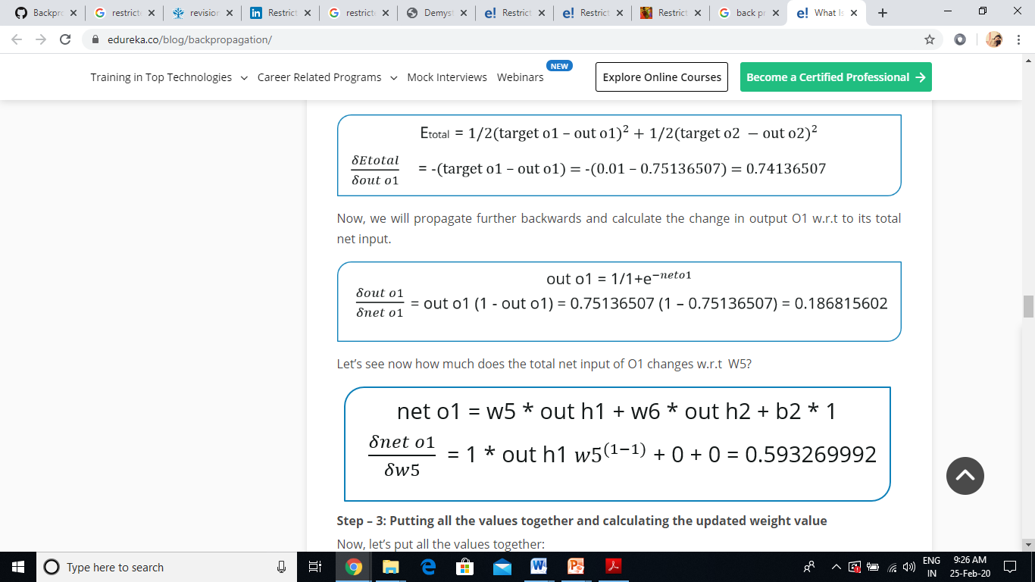
Backward Pass
Notes:
Note it is the relative weight values which make the difference. If we multiply all final weights by a constant ( e.g. ,1) we still get the same results. For perceptron same as if the initial learning rate had been .1,
How would it generalize to novel. Show examples

Slide 8
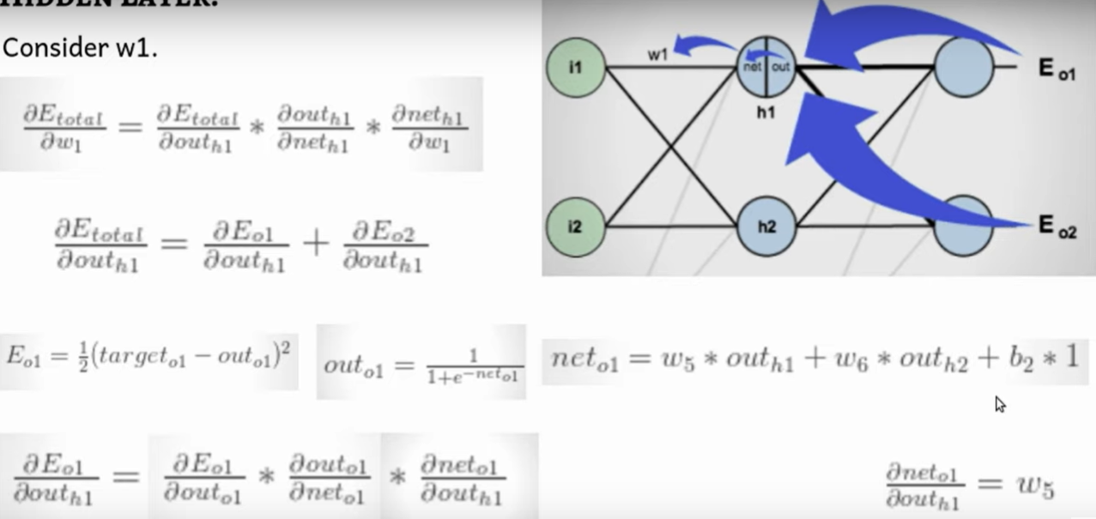

Slide 9
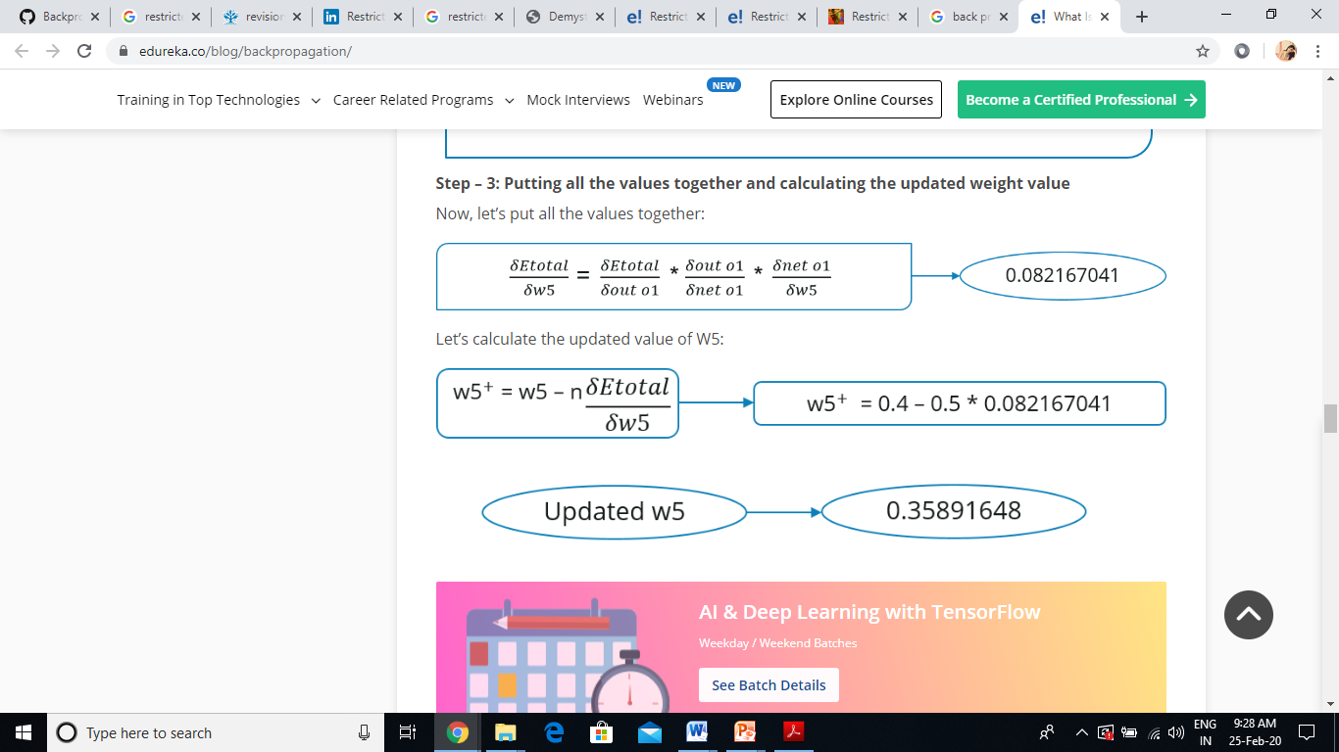
Step3: Updation of Weights

Slide 10
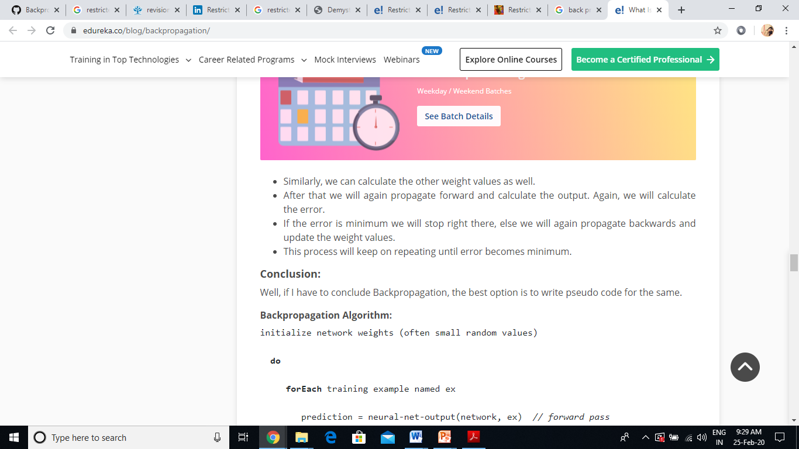
…Updation of Weights

Slide 11
Variance Vs Bias

Slide 12
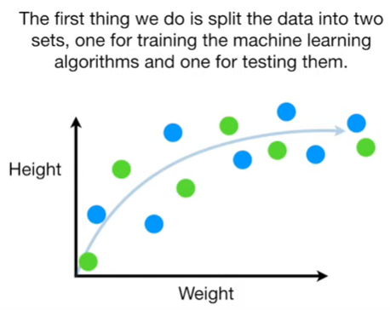
Variation Vs Bias
If no bias weight then the hyperplane must go through the origin
Notes:
What if no bias?

Slide 13
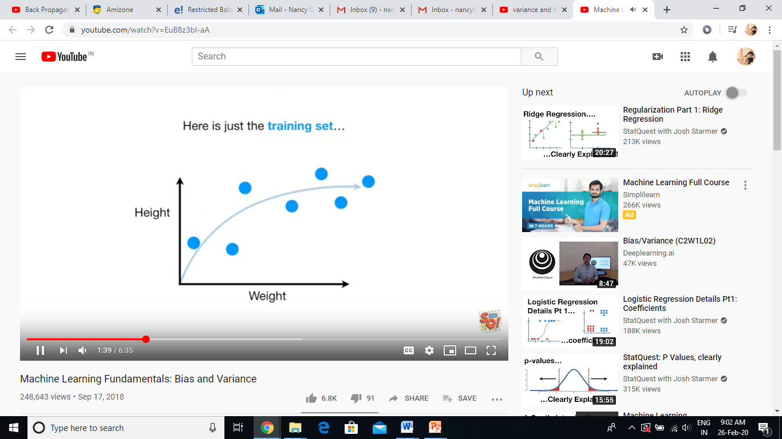
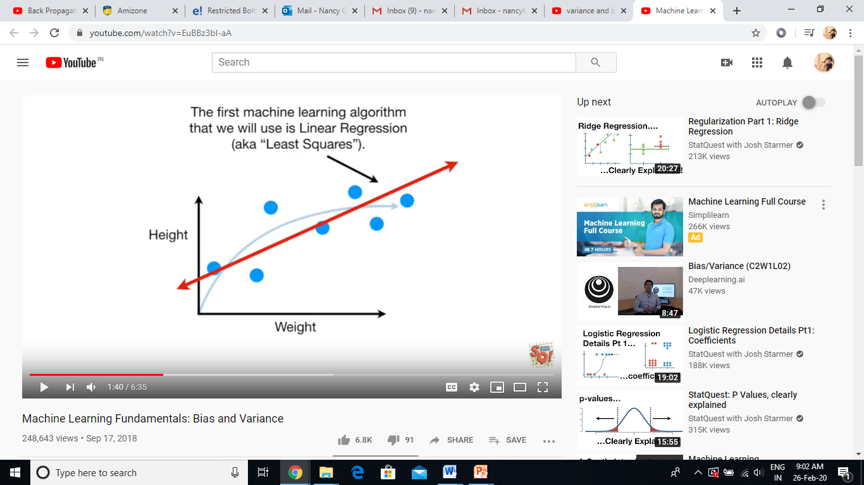
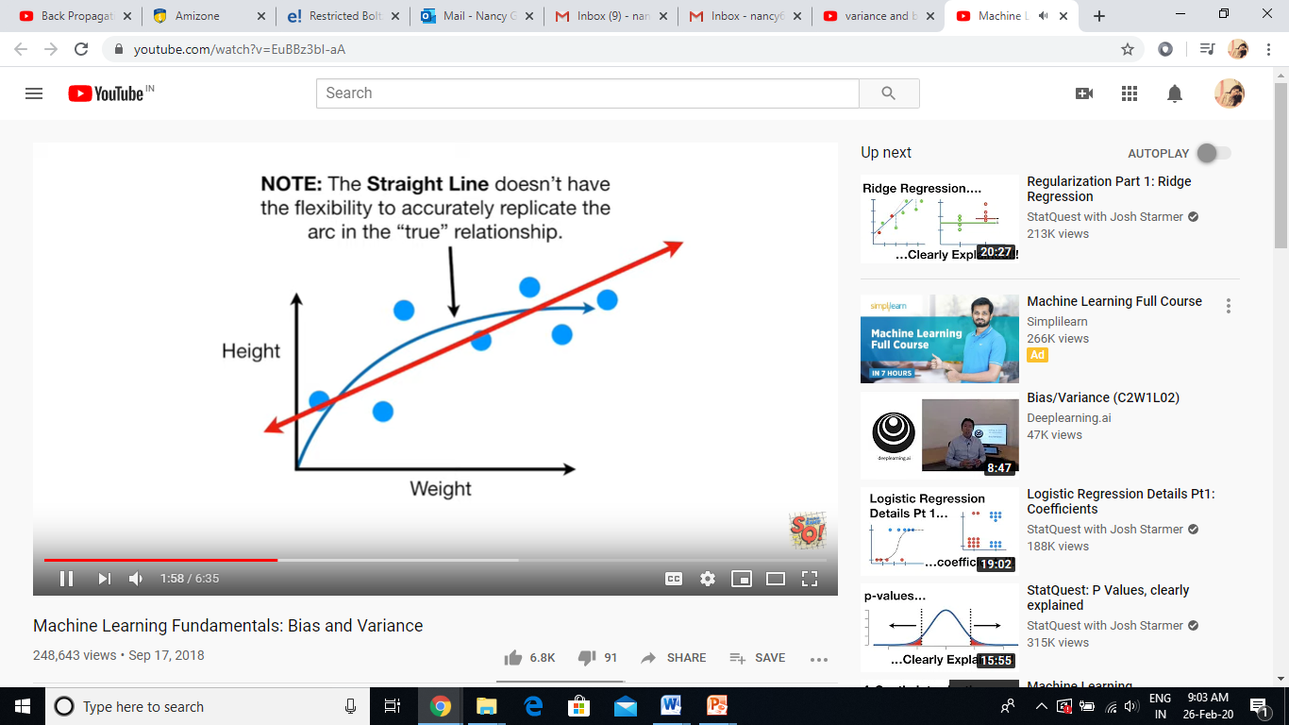
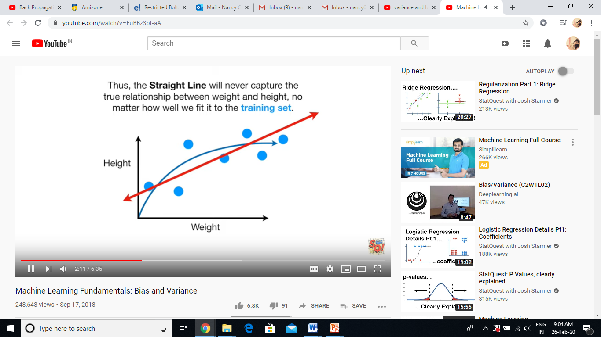

Slide 14
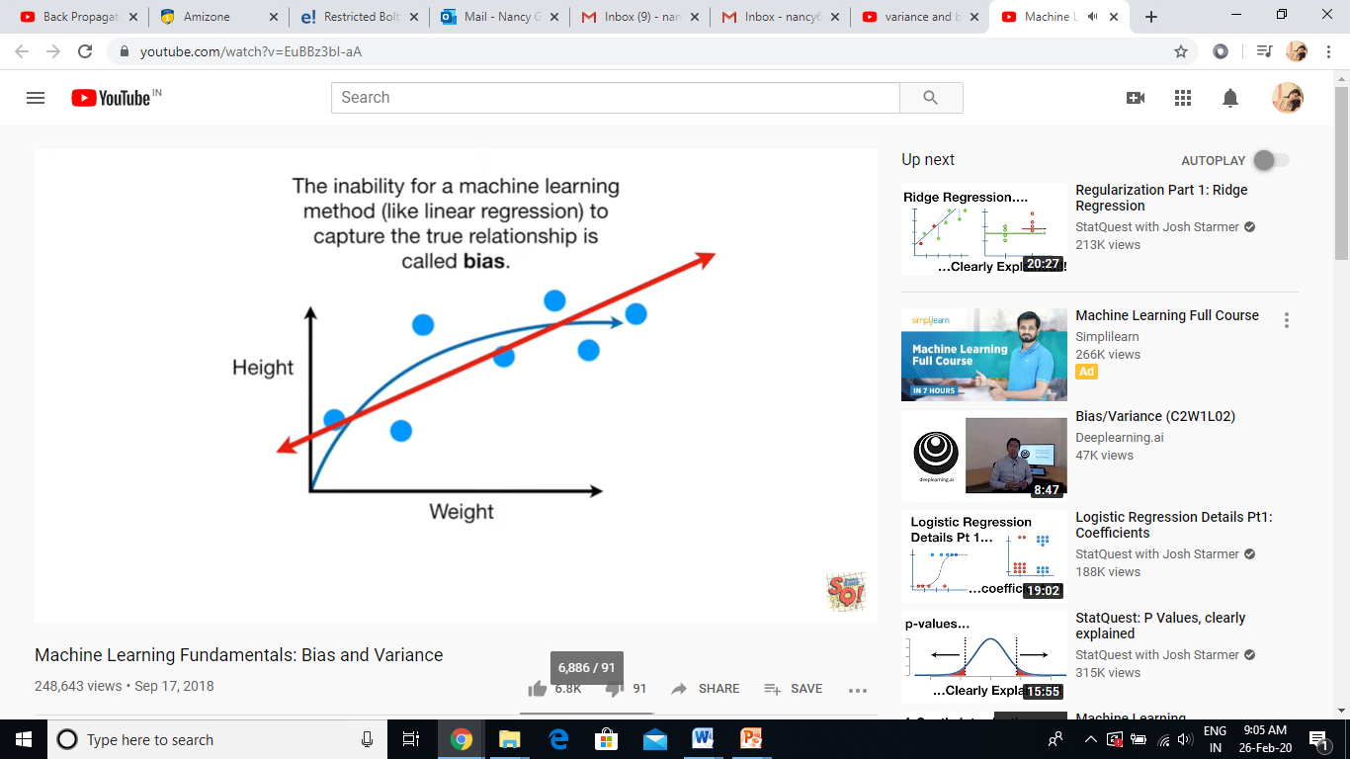
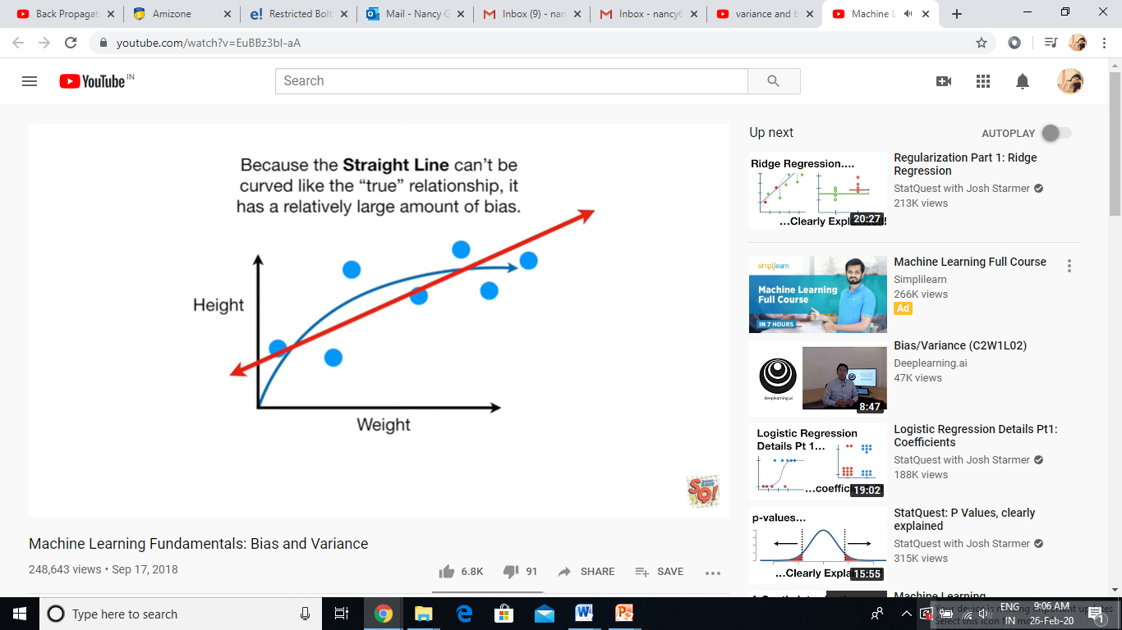
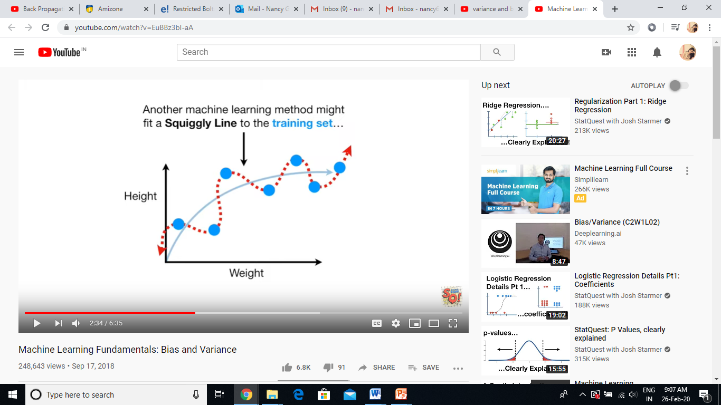
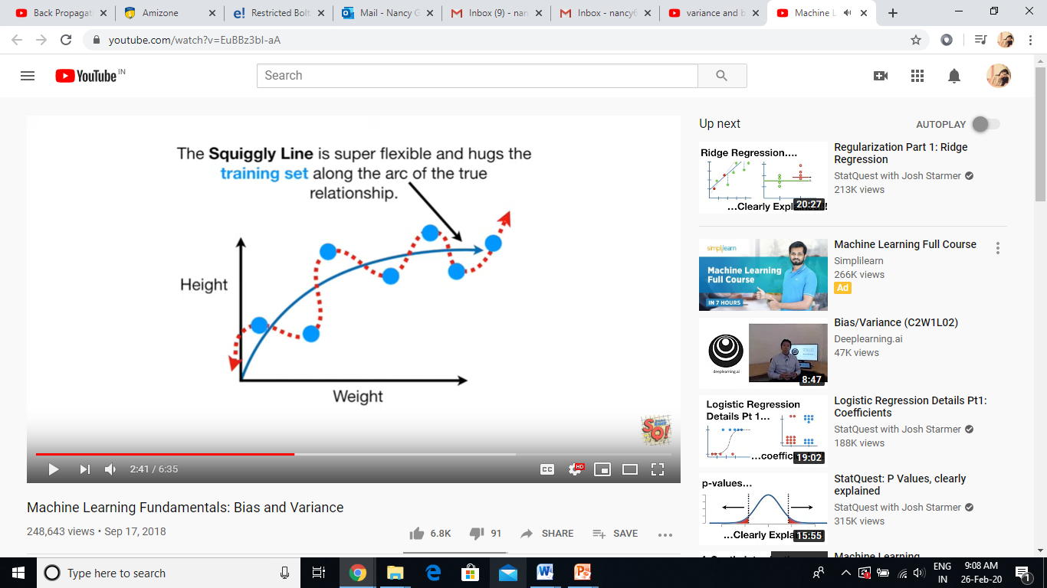

Slide 15
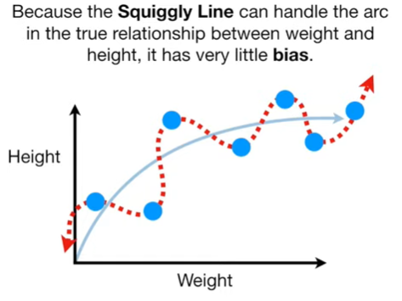

Slide 16
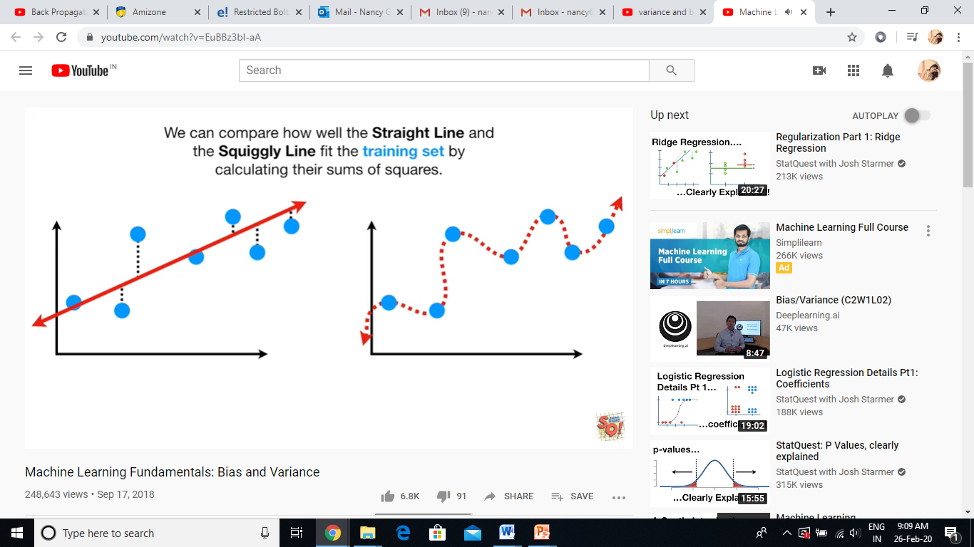
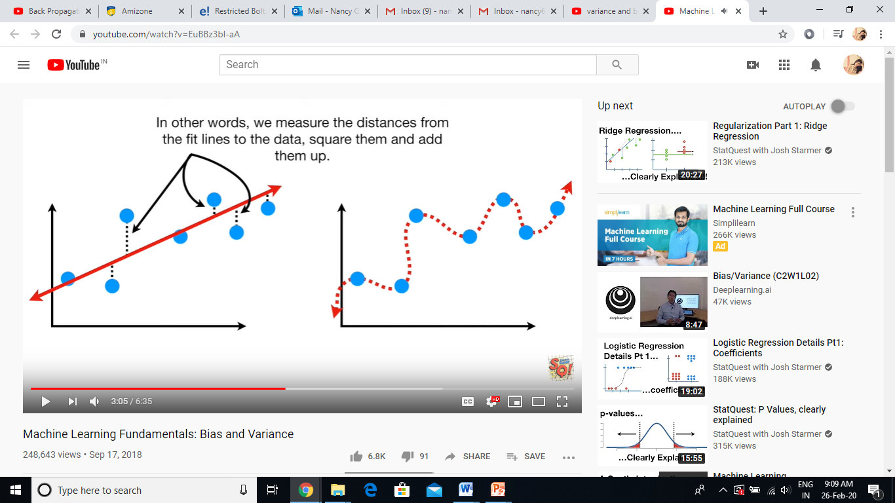

Slide 17
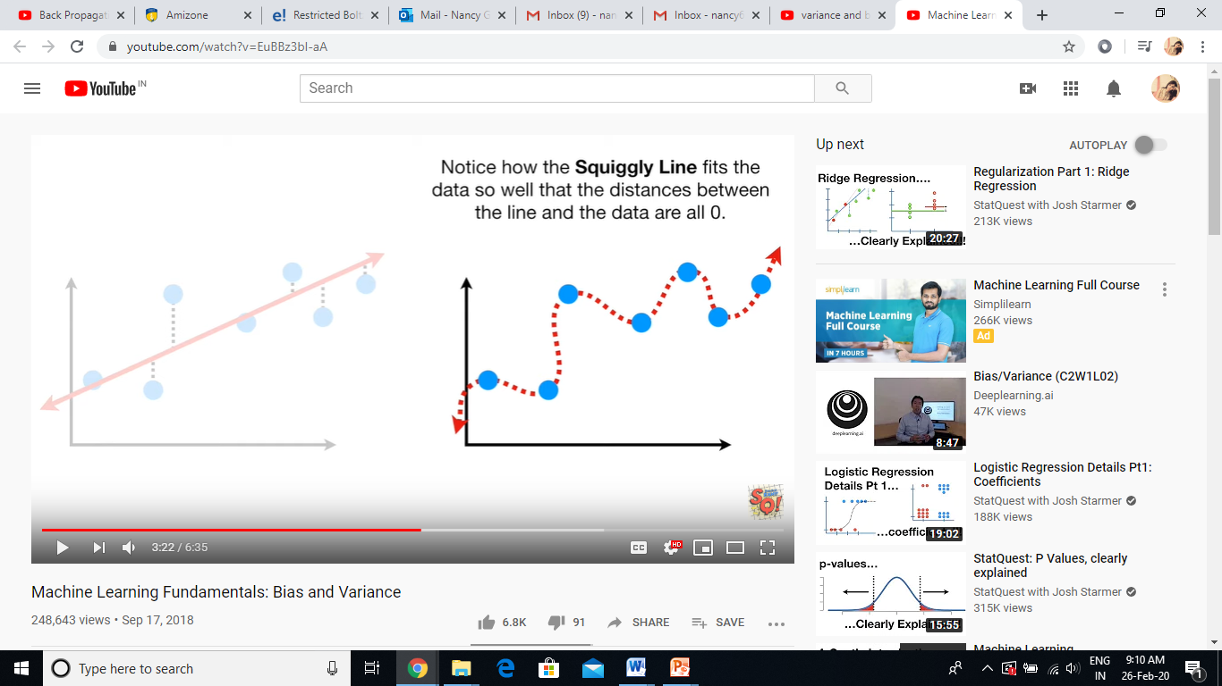

Slide 18

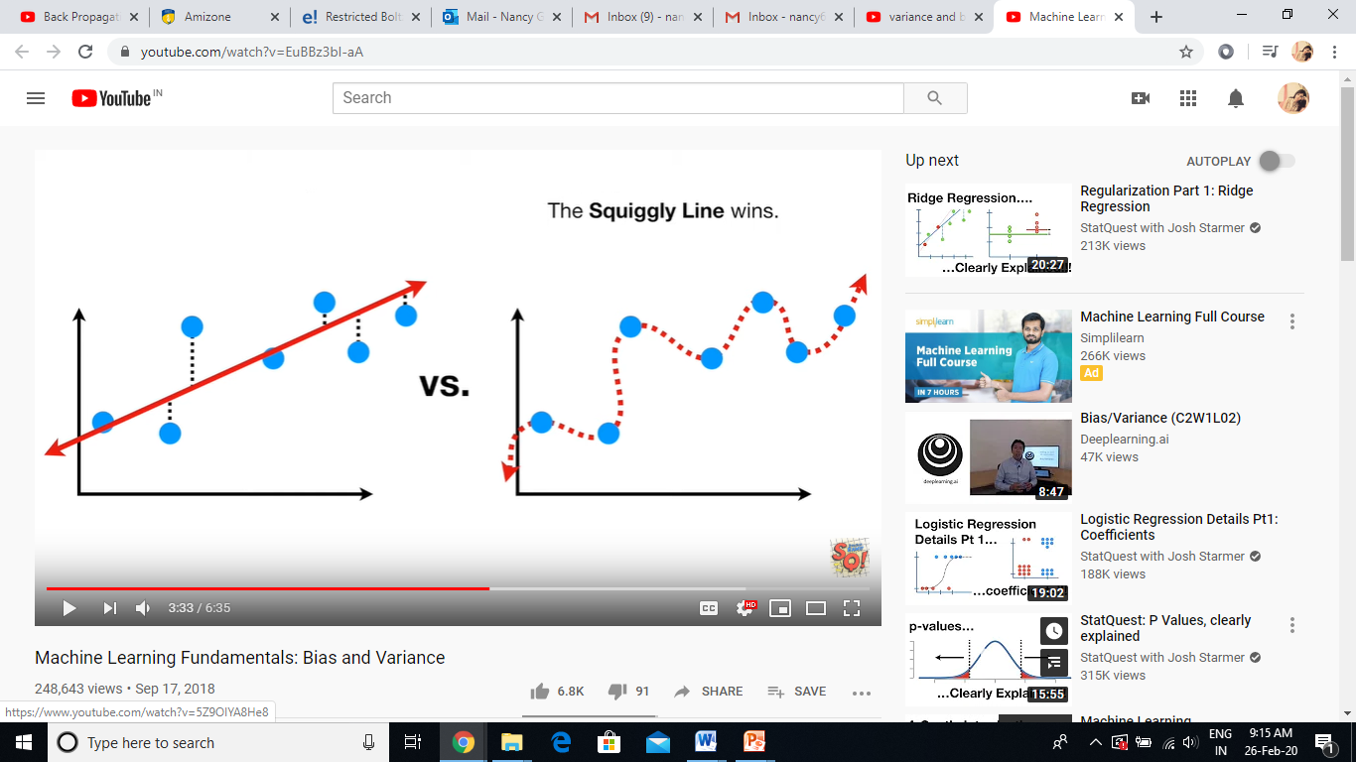

Slide 19
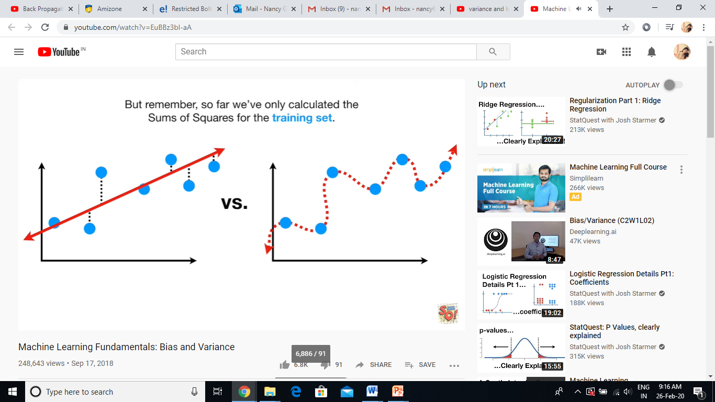
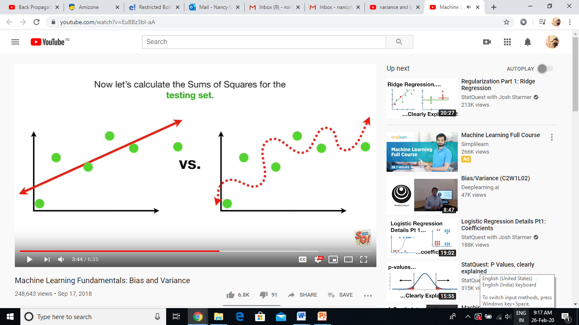

Slide 20
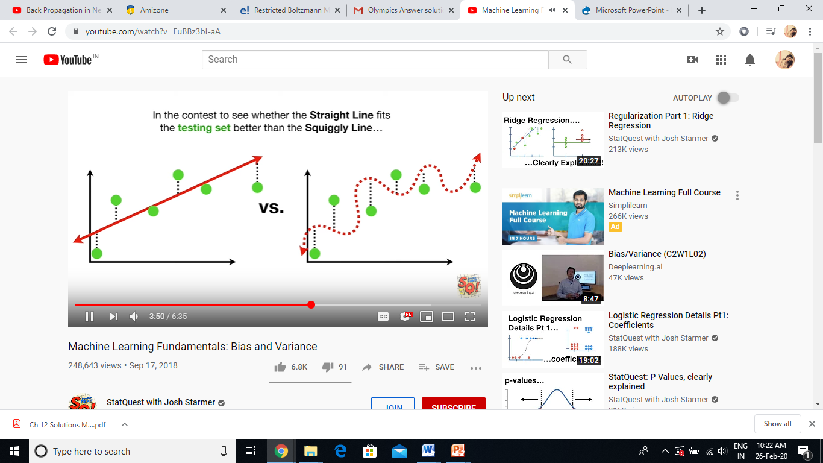
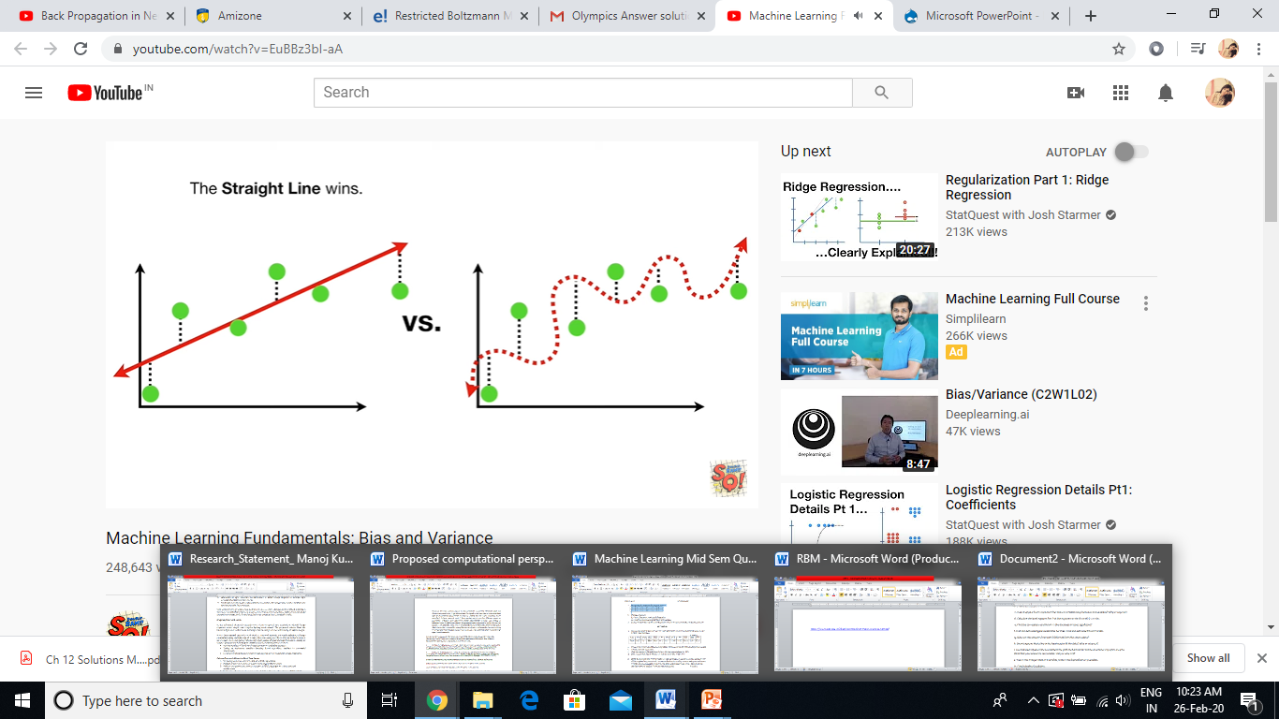

Slide 21
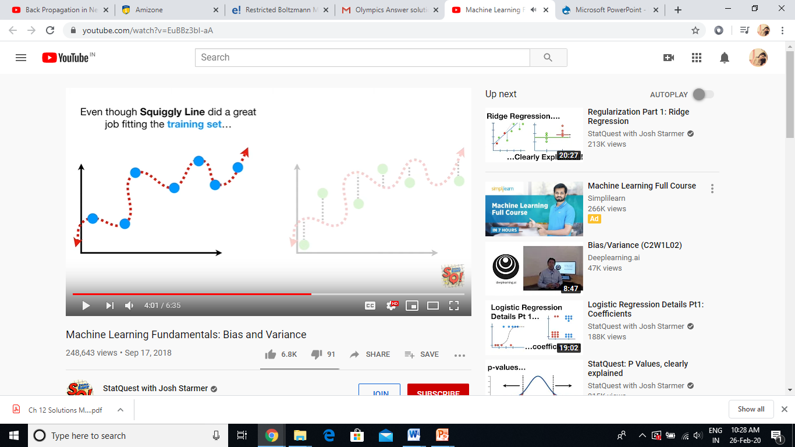
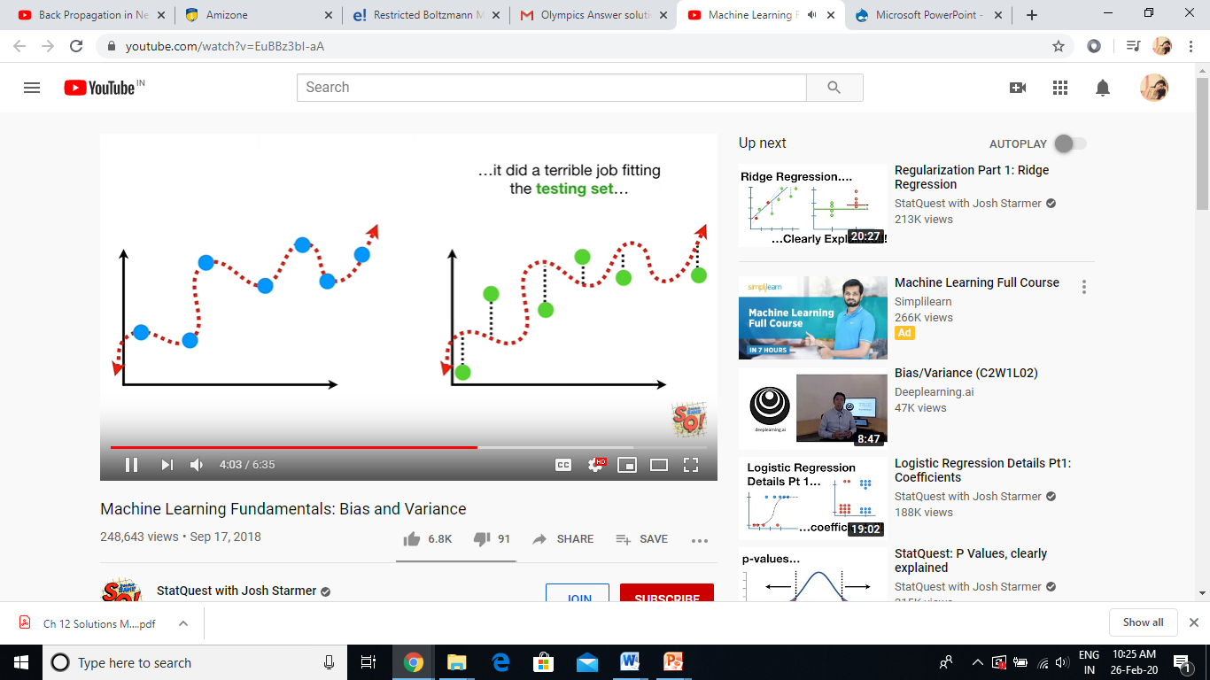
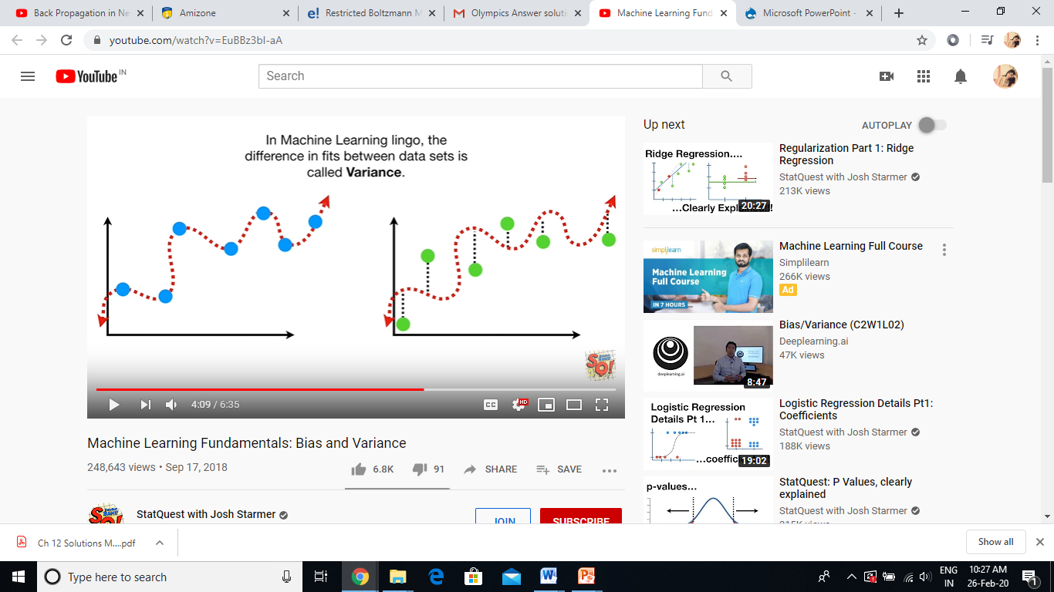

Slide 22
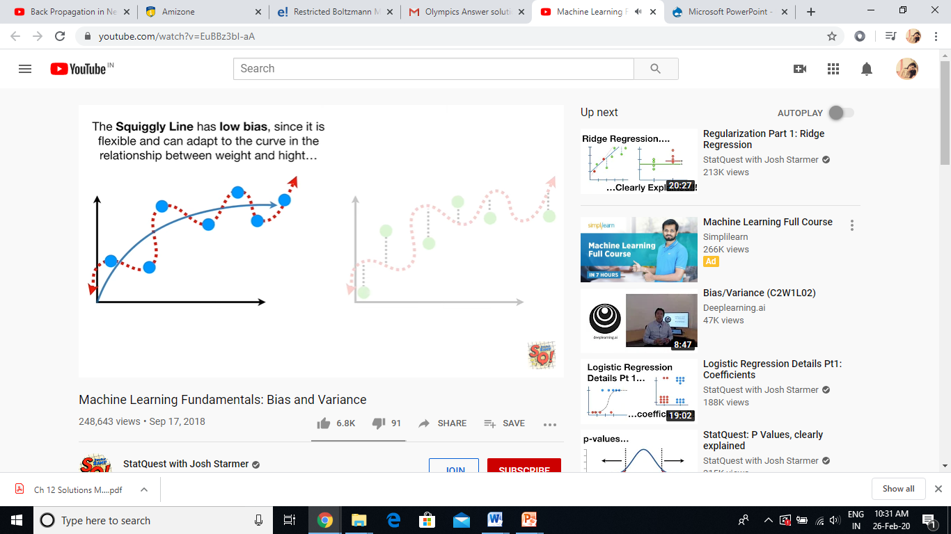
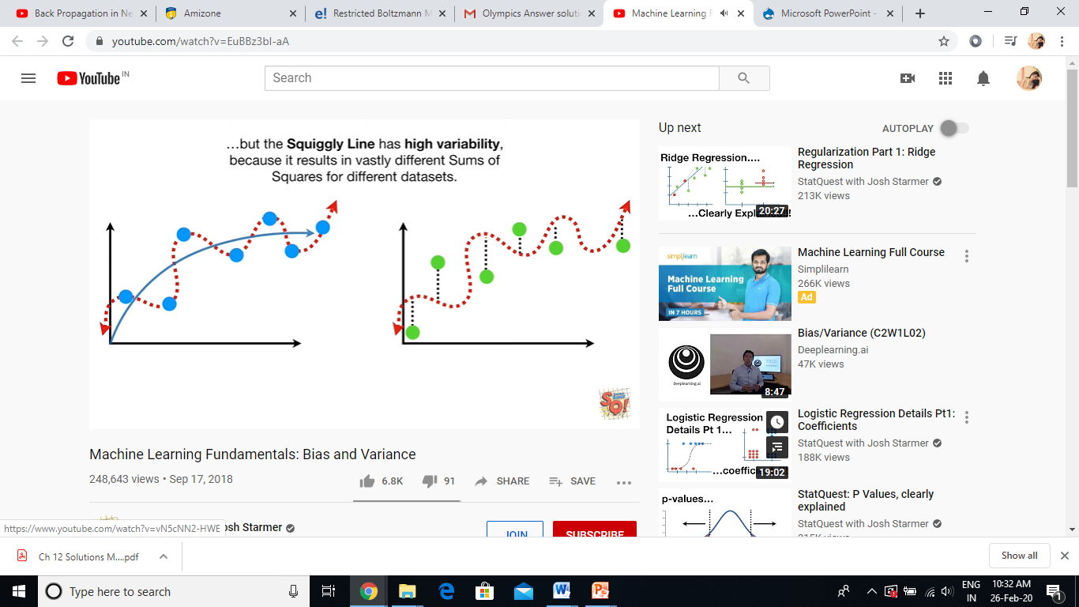
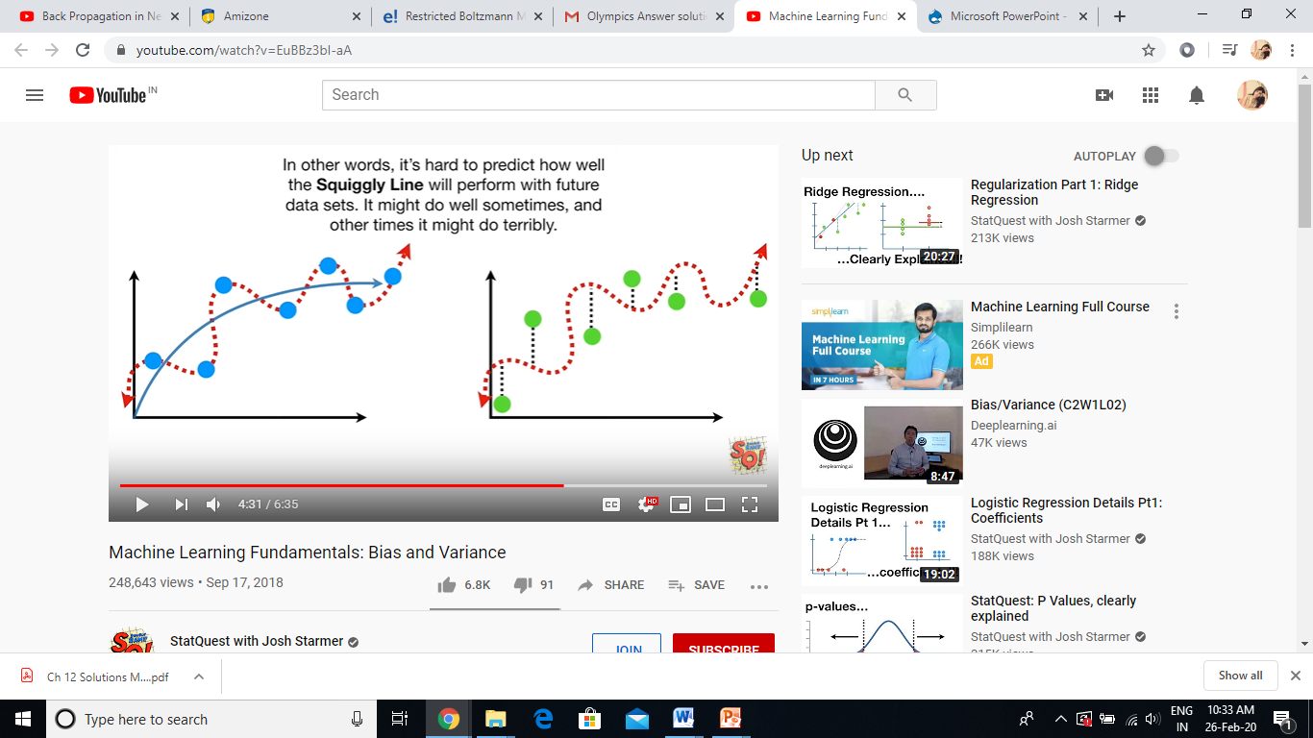

Slide 23
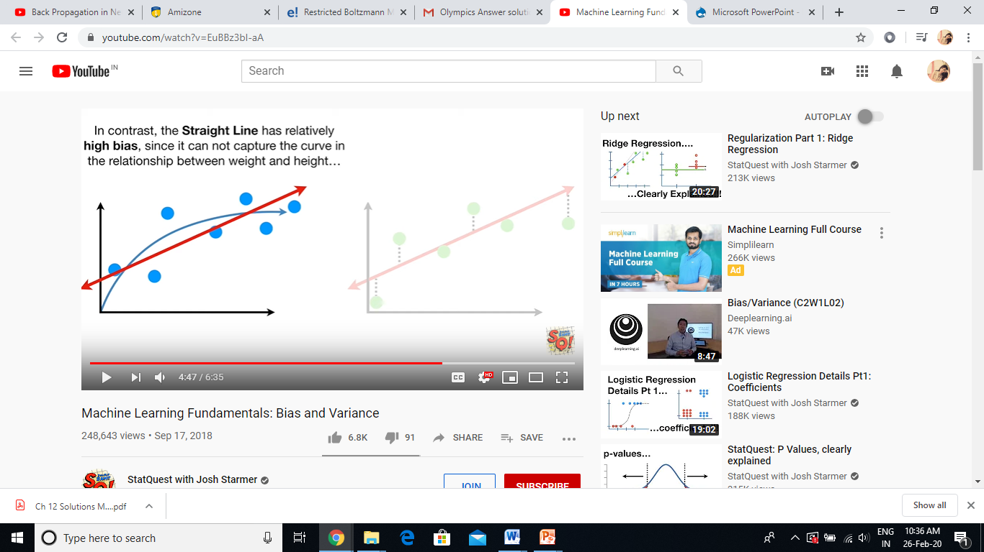
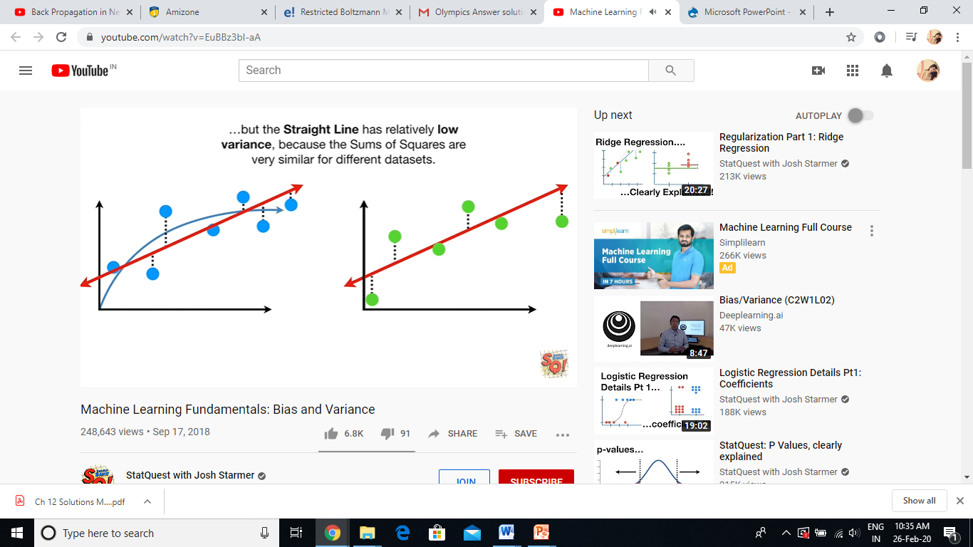
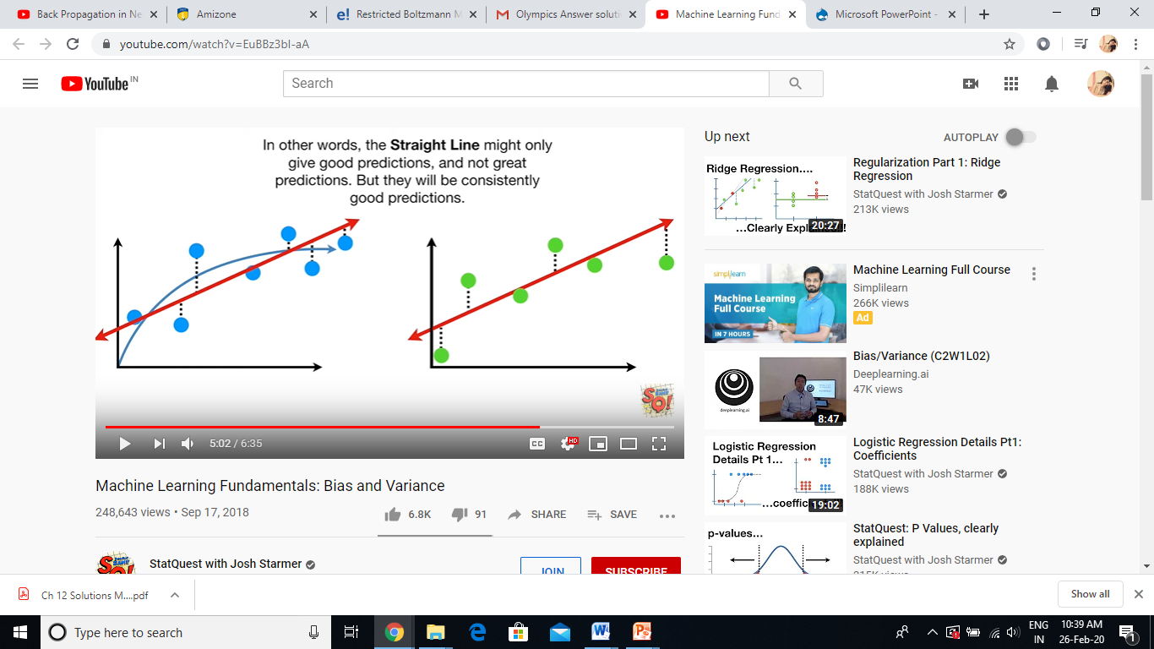
In Training Phase

Slide 24
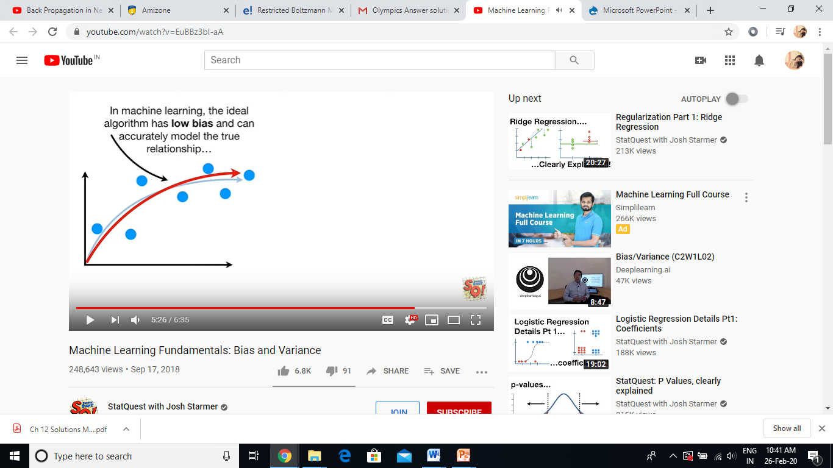
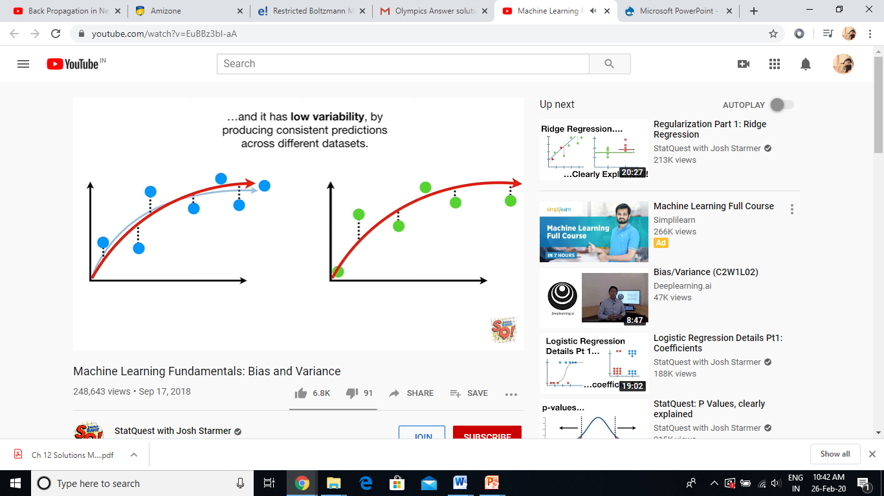

Slide 25
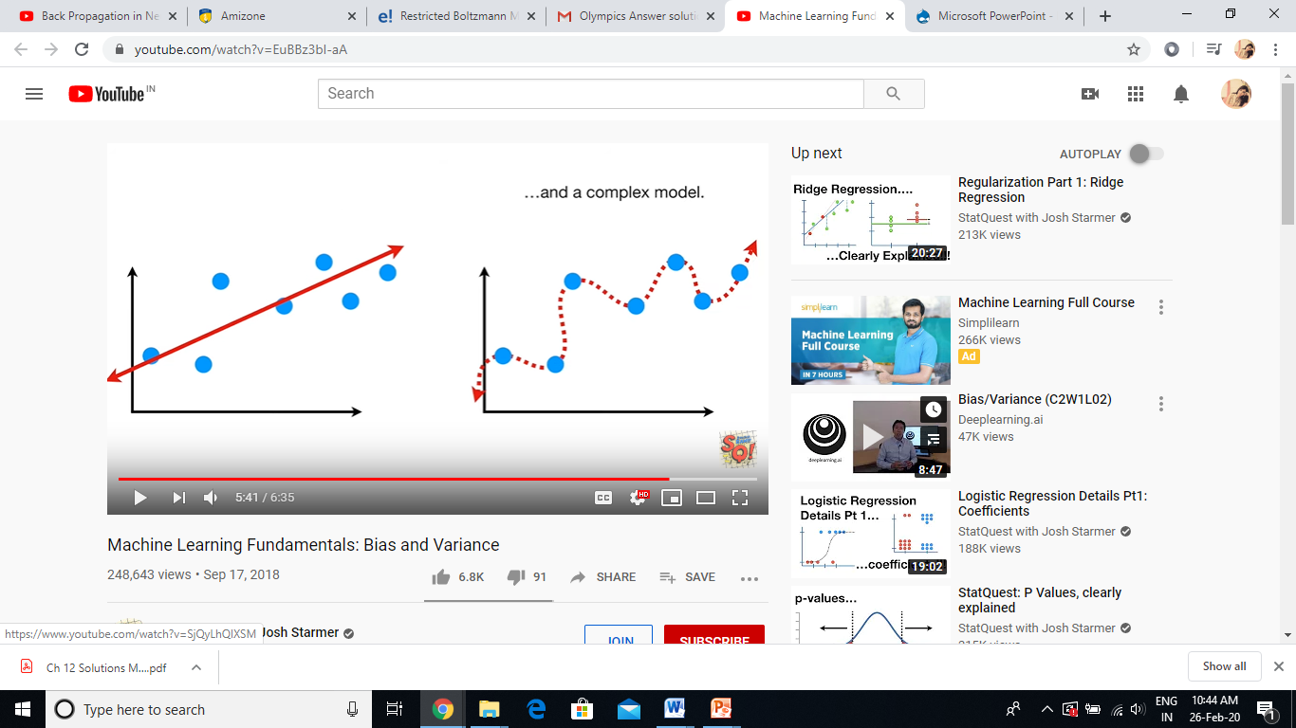
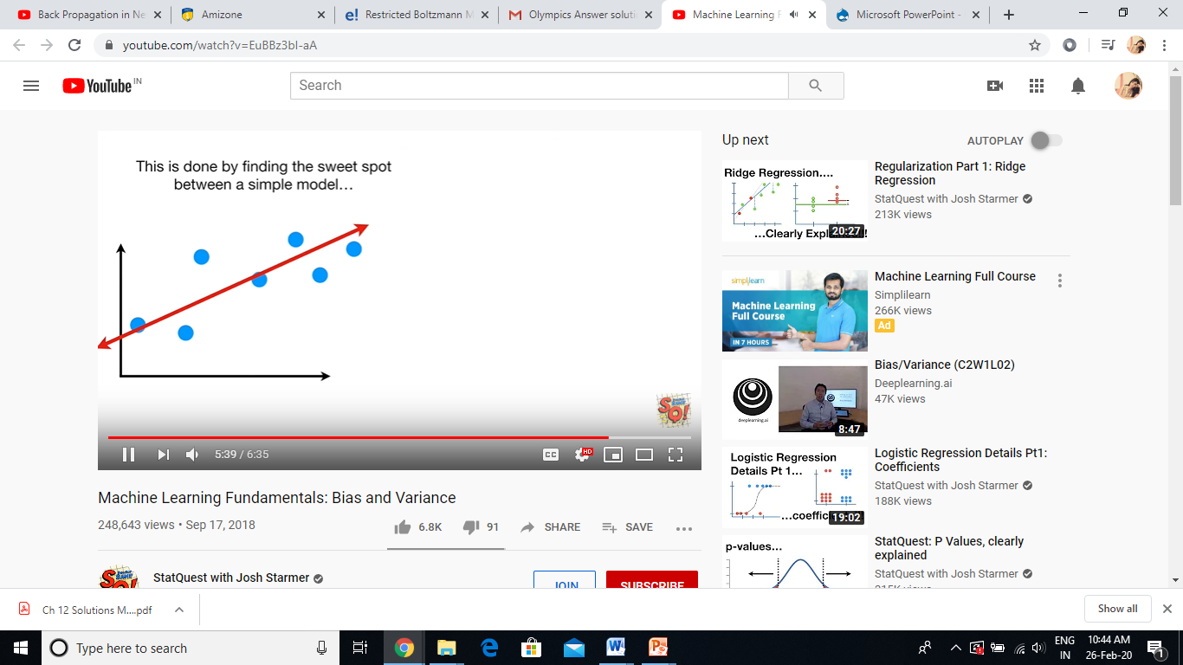
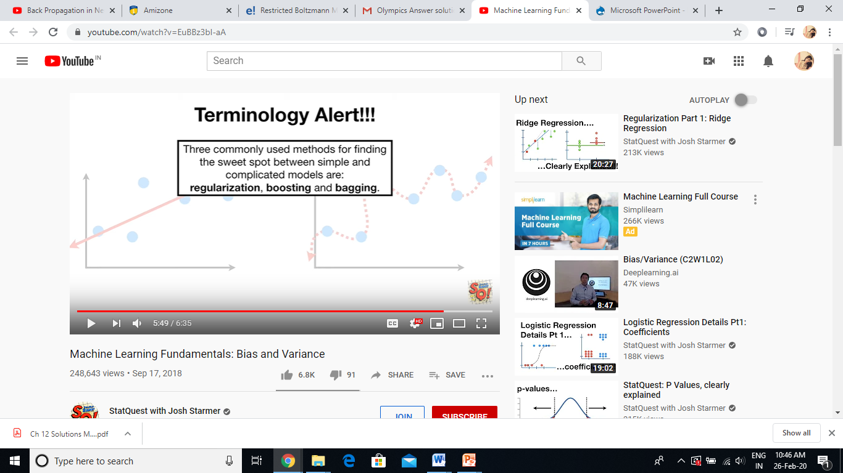

Slide 26
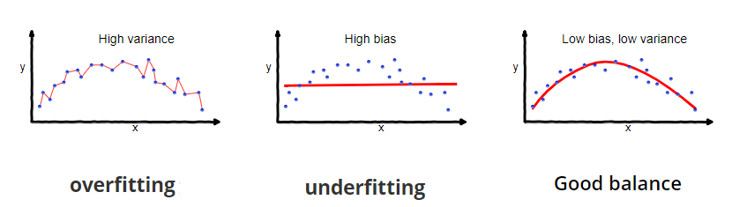
Bias And Variance
What is Bias?
Bias is the difference between the average prediction of our model and the correct value which we are trying to predict. Model with high bias pays very little attention to the training data and oversimplifies the model. It always leads to high error on training and test data.
What is Variance?
Variance is the variability of model prediction for a given data point or a value which tells us spread of our data. Model with high variance pays a lot of attention to training data and does not generalize on the data which it hasn’t seen before. As a result, such models perform very well on training data but has high error rates on test data.

Slide 27

Why is Bias Variance Tradeoff?
If our model is too simple and has very few parameters then it may have high bias and low variance. On the other hand if our model has large number of parameters then it’s going to have high variance and low bias. So we need to find the right/good balance without overfitting and underfitting the data.
Total Error = Bias^ 2 + Variance + Irreducible Error
An optimal balance of bias and variance would never overfit or underfit the model.

